Slide 1
104KM Enterprise Information System
Topic: Normalisation
Learning outcomes for today:
Data Redundancy
Functional Dependency
Process of Normalisation
Summary

Slide 2
Normalisation
Is a database technique that starts by examining the functional dependencies (i.e. relationship) between attributes.
It employs a series of test (called normal forms) to identify the optimal grouping of attributes that support the enterprise’s data requirement.
Normalisation is a technique for producing a set of relations with desirable properties, given the data requirement of an enterprise.

Slide 3
Purpose of Normalisation
The characteristics used to identify a set of relations includes the following:
The minimal number of attributes necessary to support the data requirements of the enterprise;
Attributes with a close logical relationship (described as functional dependency) are found in the same relation;
Minimal redundancy, with each attribute represented only once, with the important exception of attributes that form all or part of foreign keys, which are essential for the joining of related relations.

Slide 4
Data Redundancy and Update Anomalies
Recalling, the main aim of database design is to group attributes into relations in order to minimize data redundancy.
The potential benefits for the implemented database includes;
Reducing data inconsistencies as a result to data update in the database
Reducing cost as a result of reduction in storage space

Slide 5
Data Redundancy and Update Anomalies
Relational database also relies on the existence of a certain amount of data redundancy
This redundancy is in the form of copies of primary keys (or candidate keys) acting as foreign keys in related relations to enable modelling of relationships between data.

Slide 6
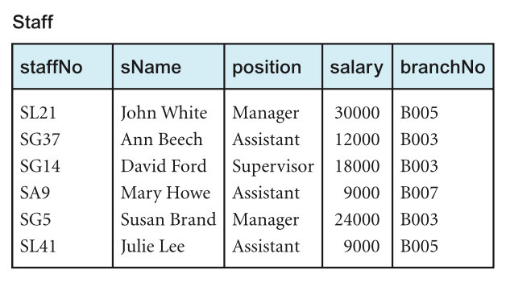
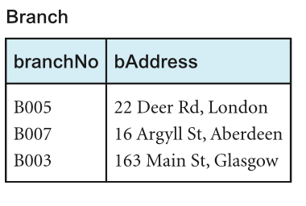
Example
Let’s consider the Staff and Branch relation below with the relation having the following form:
Staff (staffNo, sName, position, salary, branchNo)
Branch (branchNo, bAddress)
StaffBranch (staffNo, sName, position, salary, branchNo, bAddress)

Slide 7
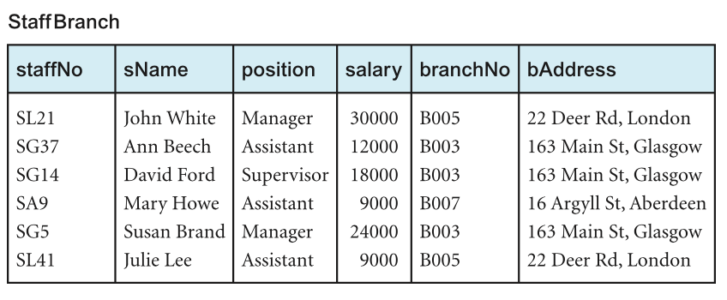
Example
The problem associated with unwanted data redundancy can be illustrated by comparing the staff and Branch relations with the StaffBranch relation below:

Slide 8
Example
In the StaffBranch relation there is redundant data;
The details of a branch are repeated for every member of staff located at that branch.
In contrast;
The branch details appear only once for each branch in the Branch relation.
Only the branch number branchNo is repeated in the Staff relation to represent where each member of staff is located.
Relations that have redundant data may have problems called update anomalies, which are classified as insertion, deletion, or modification anomalies.

Slide 9
Insertion Anomalies
Insertion Anomaly occurs when certain attributes cannot be inserted into the database without the presence of another.
There are two main types of insertion anomaly, illustrated using the StaffBranch relation.
Inserting the details of a new staff member requires inclusion of the branch which the staff would be based.
Inserting details of a new branch that currently has no staff requires entering nulls into the attributes for staff. However, as staffNo is the primary key for the StaffBranch relation, attempting to enter nulls for staffNo violates entity integrity, and is not allowed.

Slide 10
Deletion Anomalies
Deletion Anomaly occurs when certain attributes are lost because of deletion of another attribute.
Deleting tuple from StaffBranch relation that represents the last member of staff located at a branch, the details about that branch are also lost from the database.
E.g. deleting the tuple for SA9 (Mary Howe) from the StaffBranch relation, the details relating to branch number B007 are lost from the database.

Slide 11
Modification Anomalies
Modification Anomaly occurs when there is a change (addition, substitution or deletion) of data from the database.
Changing one attribute of a particular branch in the StaffBranch relation (e.g. address for branch B003), we must update the tuples of all staff located at that branch.
Failure to do would result in an inconsistent feature in the database (e.g. Branch B003 may appear to have multiple addresses).

Slide 12
Part 2
Functional Dependency

Slide 13
Functional Dependencies
Is an important concept associated with normalisation that by describing the relationship between attributes in a relation.
It is a property of the meaning of the attributes in a relation. The semantics indicates how attributes relate to one another, and specify the functional dependencies between attributes.
When a functional dependency is present, the dependency is specified as a constraint between attributes.

Slide 14
Characteristics of Functional Dependencies
Let’s assume that a relational model has attributes with unique names (A, B, C, …… Z) and the database is described by a single universal relation called R = (A, B, C, …… Z).
If A and B are attributes of relation R, B is functionally dependent on A (denoted by A ® B), if each value of A is associated with exactly one value of B.

Slide 15
Example of Functional Dependency
The relationship between staffNo and position is one-to-one (1:1) ( i.e. for each staff number there is only one position).
The relationship between position and staffNo is one-to-many (1:*) (i.e. Several staff numbers associated with a given position).
StaffNo is the determinant of this functional dependency.

Slide 16
Example of Functional Dependency that holds for a long time
Considering the values for staffNo an sName attributes, for a specific staffNo we can determine the name for that staff.
Therefore, we can conclude that staffNo attributes formally determines the sName attribute and/or sName attribute functionally determines the staffNo attribute.
Assuming the staffBranch relation shows all possible values for staffNo and sName, then the following functional dependency holds:
staffNo ® sName
sName ® staffNo

Slide 17
Example of Functional Dependency that holds for a long time
However, if the values represents a set off values for staffNo and sName attributes at a given moment in time, then such relationship isn’t of interest.
As the functional dependency wouldn’t hold for all possible values for attributes of the relation. This is known as integrity constraints.
Integrity constraints indicates the limitations on the values a relation can legitimately assume.

Slide 18
Example of Functional Dependency that holds for a long time
In this case, the relationship between staffNo and sName is one-to-one (1:1): for each staff number there is only one name.
On the other hand, the relationship between sName and staffNo is one-to-many (1:*): there can be several staff numbers associated with a given name.
The functional dependency that holds is
staffNo ® sName

Slide 19
Full and Partial Functional Dependency
Additional characteristics of functional dependency necessary for normalization is that their determinant should have the minimal number of attributes necessary to maintain the functional dependency. This is called full functional dependency.
Full functional dependency indicates that if A and B are attributes of a relation, B is fully functionally dependent on A if B is functionally dependent on A, but not on any proper subset of A. (i.e. removal of any attribute from A results in the dependency no longer existing).
Partial functional dependency indicates that if A and B are attributes of a relation, B is partial functional dependent on A if there is some attribute that can be removed from A and yet the dependency still holds.

Slide 20
Example of Partial and Full Functional Dependency
Let’s consider the functional dependency below:
staffNo, sName ® branchNo
Each value of (staffNo, sName) is associated with a single value of branchNo
However, It is not a full functional dependency as branchNo is also functionally dependent on a subset of (staffNo, sName) namely staffNo. This is an example of partial functional dependency.
The functional dependency would be:
staffNo ® branchNo

Slide 21
Transitive Dependency
A condition where A, B, and C are attributes of a relation such that if A ® B and B ® C, then C is transitively dependent on A via B (provided that A is not functionally dependent on B or C).
Let’s consider the functional dependency below
staffNo ® sName, position, salary, branchNo, bAddress branchNo ® bAddress
The transitive dependency branchNo ® bAddress exists on staffNo via branchNo. In other words, the staffNo attribute functionally determines the bAddress via the branchNo attribute and neither branchNo nor bAddress functionally determines staffNo.

Slide 22
Example - Identifying Function Dependency using Meaning and Relationship
Assuming that the position held and the branch determine a member of staff’s salary. We identify the functional dependencies based on our understanding of the attributes in the staffBranch relation as:
staffNo ® sName, position, salary, branchNo, bAddress
branchNo ® bAddress
bAddress ® branchNo
branchNo, position ® salary
bAddress, position ® salary
We identify five functional dependencies with staffNo, branchNo, bAddress, (branchNo, position), and (bAddress, position) as determinants.
For each functional dependency, we ensure that all the attributes on the right-hand side are functionally dependent on the determinant on the left-hand side.

Slide 23
Example - Identifying Relation’s Primary Key using Functional Dependency
Recalling the determinants functional dependencies identified earlier for the staffBranch relation staffNo, branchNo, bAddress, (branchNo, position), and (bAddress, position).
Identifying the candidate key(s) for the StaffBranch relation, requires identifying the attribute (or group of attributes) that uniquely identifies each tuple in this relation.
For relation with more than one candidate key, we identify the candidate key that is to act as the primary key for the relation.
All attributes that are not part of the primary key (non-primary-key attributes) should be functionally dependent on the key.

Slide 24
Example - Identifying Relation’s Primary Key using Functional Dependency
The only candidate key of the StaffBranch relation, and therefore the primary key, is staffNo, as all other attributes of the relation are functionally dependent on staffNo.
Although branchNo, bAddress, (branchNo, position), and (bAddress, position) are determinants in this relation, they are not candidate keys for the relation.

Slide 25
Summary
Identifying all functional dependencies between a set of attributes can be achieved if the meaning of each attributes and the relationship between them are well understood through user requirement specification.

